Slide 1
Sentiment Analysis of Chinese Microblog Based on Stacked Bidirectional LSTM
Yue Lu¹, Junhao Zhou¹, Hong-Ning Dai¹, Hao Wang², Hong Xiao³
¹ Macao University of Science and Technology
² Norwegian University of Science and Technology
³ Guangdong University of Technology
1

Slide 2
Outline
Motivation
The Proposed Method
Experiments
Conclusion
2

Slide 3
Outline
Motivation
The Proposed Method
Experiments
Conclusion
3

Slide 4


Sentiment Analysis
To identify the sentiment orientation of microblog texts
Positive
Negative
Microblog
Texts
Sentiment Analysis
Model
4

Slide 5
Related Works - Word Representation
0.641 excited
0.531 satisfied
0.375 cool
0.266 thought
0.063 make
-0.266 sadly
-0.531 unhappy
-0.719 annoying
Feature engineering
• Hand-crafted features
• Sentiment lexicons
Problem
Time and effort consuming
Weibo has special words to express sentiments which are daily updated and hard to collect
5

Slide 6
Can these features be manually designed?
E1. 为祖国疯狂打call
( Cheer for my country! )
E2. 陈独秀请你坐下
( Your idea was quite brilliant! )
Traditional feature engineering cannot encode semantic features automatically
6

Slide 7
Related Works - Document Representation
Sentiment Analysis
Machine learning model
Non-RNN based deep learning model
Problem
Overlook the effect of long-range dependencies in Chinese words (context features) on sentiment analysis task
0.000
have
0.000
a
0.719
nice
0.094
day
7

Slide 8
Can the sentiment orientation of the middle two sentences be correctly identified without referring to the context?
E3. 为什么要这么苛刻呢？8 分钟展现出这么多中国元素，中国科技，展现出中国的热情和自信。张艺谋导演真的是鞠躬尽瘁了。搞不懂这些人！
( Why are they so mean? This 8-minute show exhibited so many Chinese elements, Chinese technologies as well as our people's enthusiasm and confidence. The director Zhang Yimou has already tried his best. I really can't understand these people! )
Non-RNN Based Model
Positive×
Traditional Non-RNN based methods cannot deal with
long-range dependencies of words (contextual feature)
8

Slide 9
Challenges for sentiment analysis of Chinese Microblog
Traditional feature engineering cannot automatically encode semantic features
Traditional non-RNN based methods cannot deal with long-range dependencies of words (contextual features)
9

Slide 10
Outline
Motivation
The Proposed Method
Experiments
Conclusion
10

Slide 11
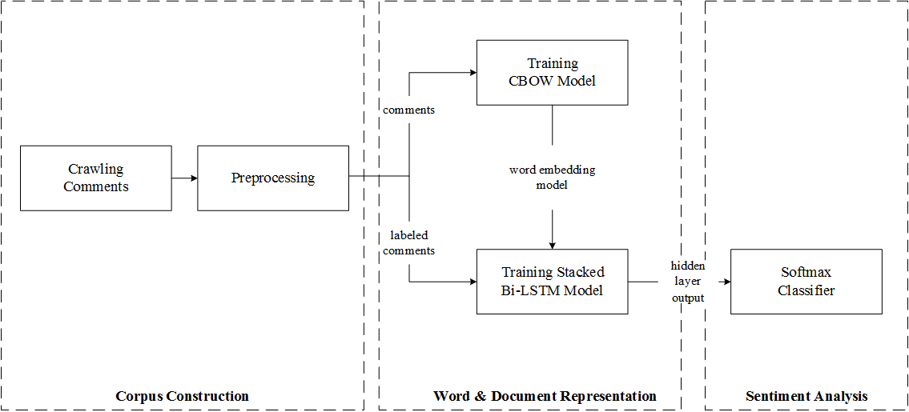
Overview of Methodology
semantic features
contextual features
11

Slide 12
Overview of Methodology
semantic features
12

Slide 13

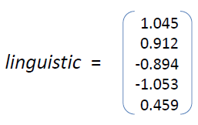
Continuous Bag-of-Words (CBOW)
A neural network based word representation(embedding) model
Proposed by Mikolov et al. in 2013
Aims to automatically encode semantic features according to the logic of natural language
The distance between two word vectors depends on their
semantic similarity
contextual similarity
excellent
remarkable
brilliant
perfect
100
elements
Beijing
...
Olympics
100-dimensional column matrix
13

Slide 14
Overview of Methodology
contextual features
14

Slide 15
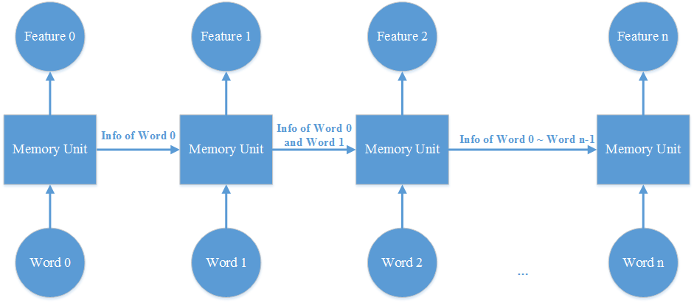
Recurrent neural network (RNN)
outputs
inputs
Problem:
RNN stores all the information from previous inputs without filtering out some useless information. (Cannot handle long-range dependencies of words)
15

Slide 16
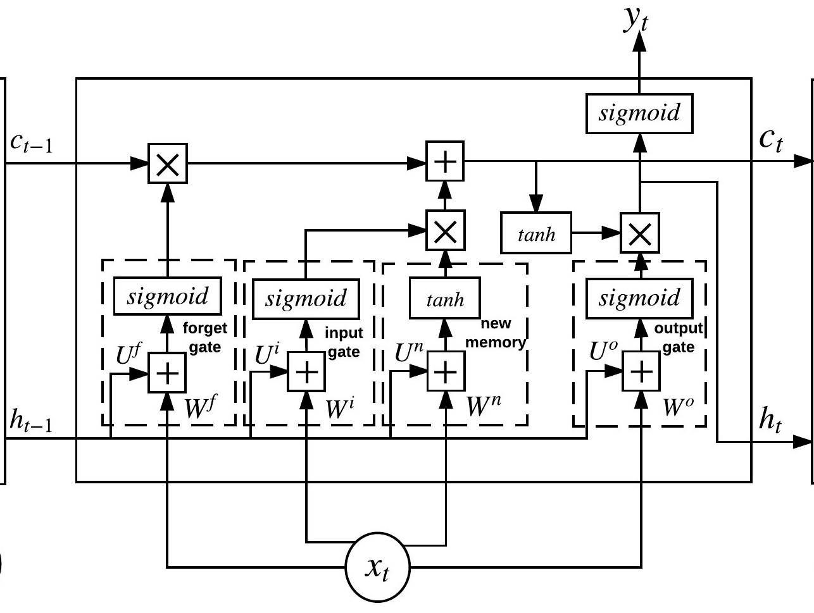

Long Short Term Memory (LSTM) ^{[1]}
forget useless info
memorize useful info
Memory Unit of LSTM ^{[2]}
[1] Hochreiter, S., & Schmidhuber, J. (1997). Long short-term memory. Neural Computation, 9(8), 1735-1780.
[2] Zhang, L., Wang, S., & Liu, B. (2018). Deep learning for sentiment analysis: a survey. Wiley Interdisciplinary Reviews Data Mining & Knowledge Discovery.
16

Slide 17
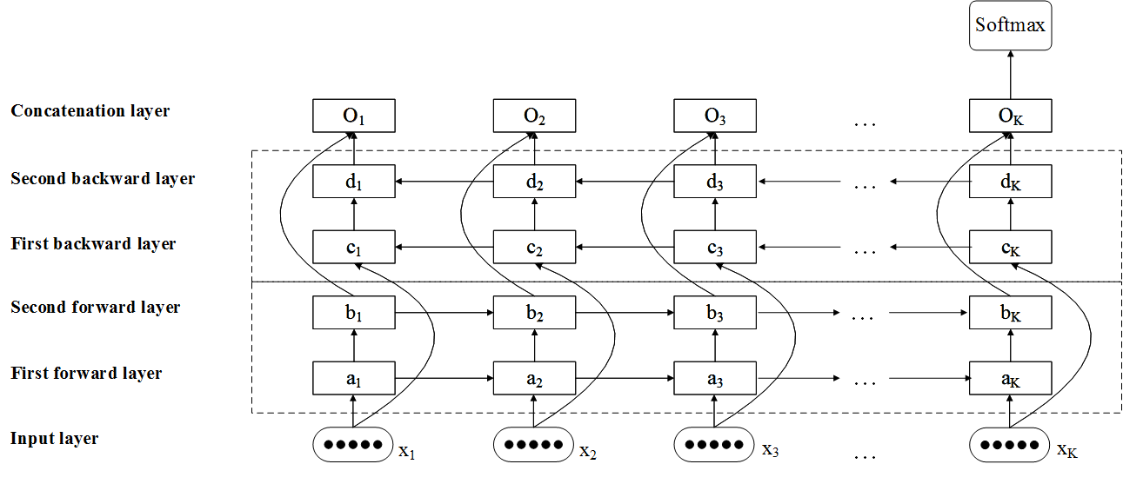
Sentiment Analysis Based on Stacked Bi-LSTM
Combining
past & future
contexts
future
contexts
past
contexts
17

Slide 18
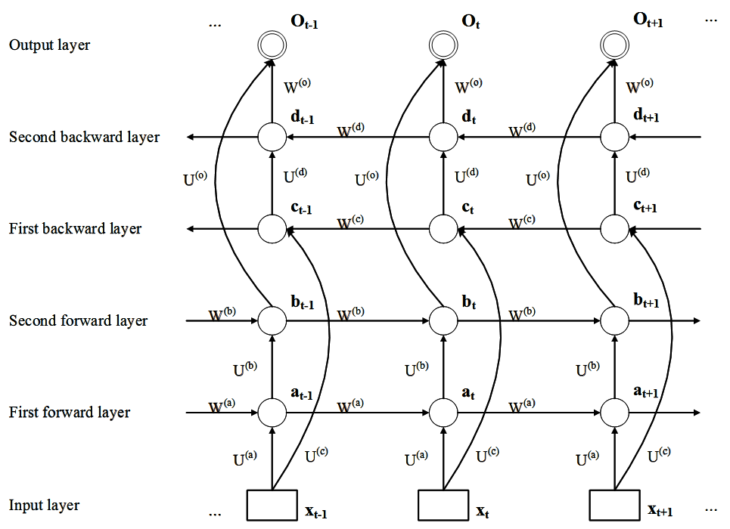
Stacked Bidirectional LSTM Model
info to be kept
info to be forgotten
: LSTM cell
18

Slide 19
Sentiment Analysis Based on Stacked Bi-LSTM
Sentiment Prediction
19

Slide 20
Outline
Motivation
The Proposed Method
Experiments
Conclusion
20

Slide 21
Experiment Setting
Data
65,536 comments for training CBOW model
3,000 labeled comments for training Stacked Bi-LSTM
1,514 positive comments
1,486 negative comments
Experimental Performance Evaluation
Descriptive statistics of testing data set
Evaluation metric
21

Slide 22
Results
The proposed method (CBOW + Stacked Bi-LSTM) outperforms any of the other methods
22

Slide 23
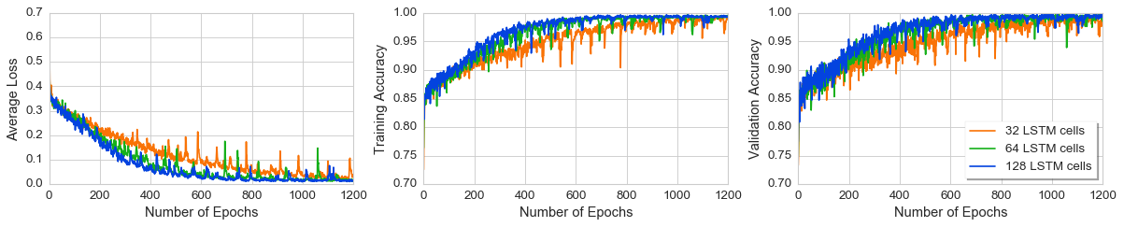
Influence of Different Factors
The performance of Stacked Bi-LSTM Model with different number of hidden cells
23

Slide 24
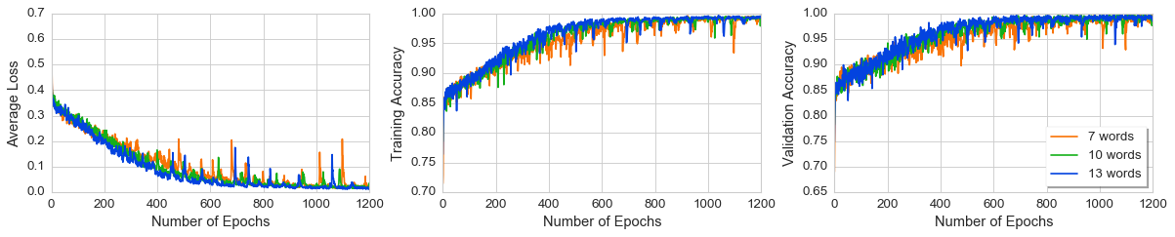
Influence of Different Factors
The performance of Stacked Bi-LSTM Model with different number of input size
24

Slide 25
Outline
Motivation
The Proposed Method
Experiments
Conclusion
25

Slide 26
Conclusion
Encode semantic properties of words using CBOW model
Abstract contextual features of documents using Stacked Bi-LSTM model
The effectiveness of CBOW+Stacked Bi-LSTM has been verified in Chinese microblogs' comments sentiment prediction
26

Slide 27
Thanks
27

Slide 29
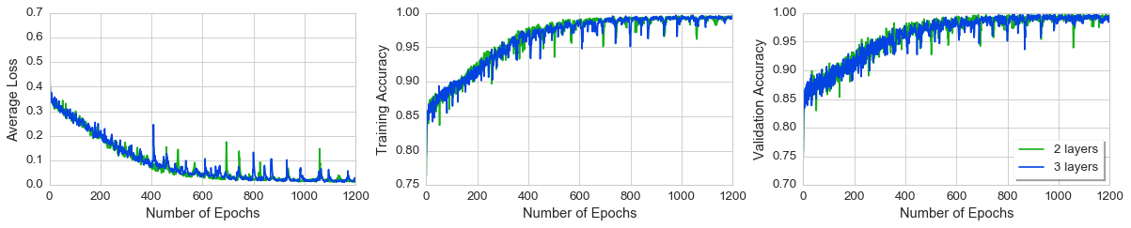
Influence of Different Factors
The performance of Stacked Bi-LSTM Model with different number of layers
25

Slide 30
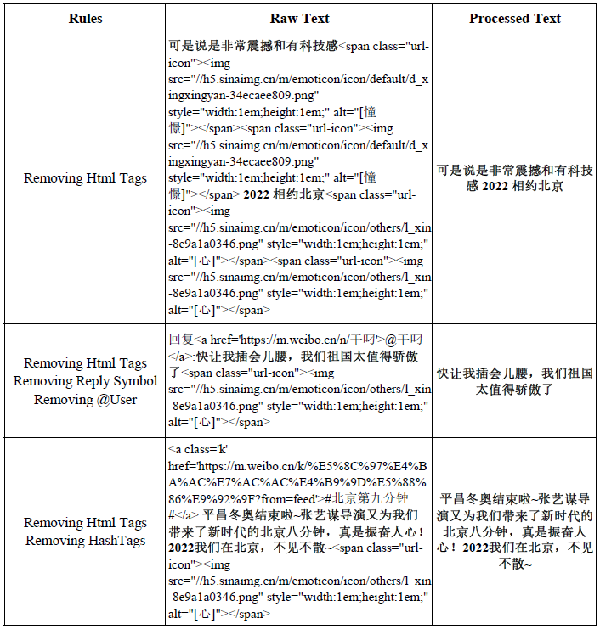
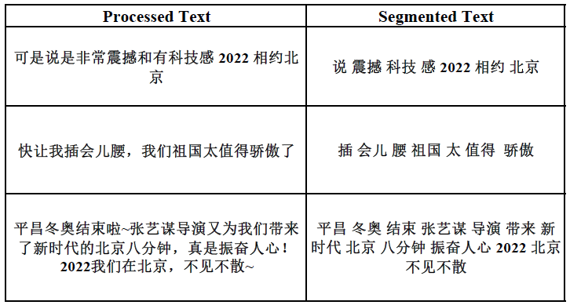
Corpus Construction
Chinese segmentation and stop word processing
Preprocessing of raw microblog text:
Removing hashtags, reply symbols and several references to user names (@user) and links.

Slide 31
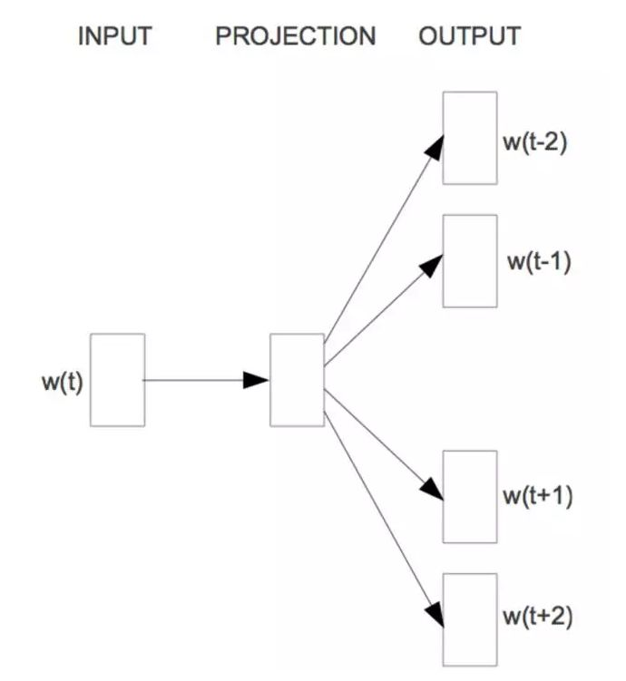
Skip-gram
current word
context words
(Mikolov et al., 2013)

Slide 32
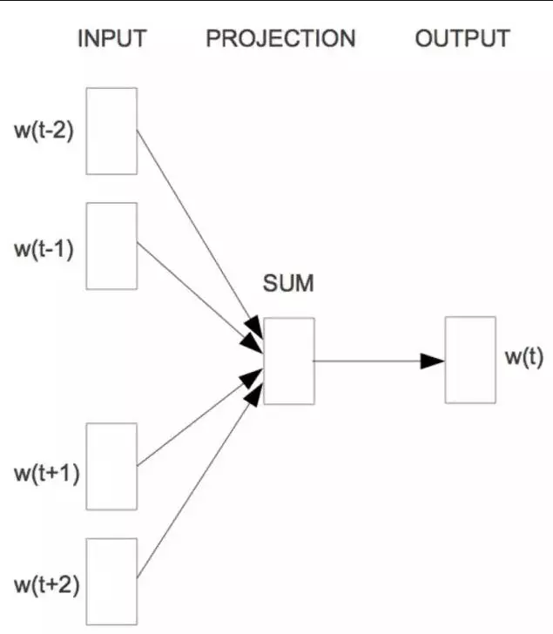
Continuous Bag-of-Words (CBOW)
context words
current word
(Mikolov et al., 2013)

Slide 33
Long Short Term Memory (LSTM) ^{[1]}
forget gate:
what information to dump from the cell state
input gate:
what new information to store in the cell state
new memory:
new candidate values after adding new input
new cell state:
update the old cell state Ct-1 into new cell state Ct
output gate:
decides which parts of the cell state to output
output of current hidden layer:
puts the cell state through the tanh function and multiplies it by the output of the sigmoid
gate
old cell state
new cell state
output from the previous hidden layer
output of current hidden layer
current input
Memory Unit of LSTM ^{[2]}
[1] Hochreiter, S., & Schmidhuber, J. (1997). Long short-term memory. Neural Computation, 9(8), 1735-1780.
[2] Zhang, L., Wang, S., & Liu, B. (2018). Deep learning for sentiment analysis: a survey. Wiley Interdisciplinary Reviews Data Mining & Knowledge Discovery.
16

Slide 34
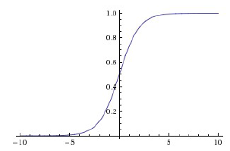
Stacked Bidirectional LSTM Model
Sigmoid
info to be kept
info to be forgotten
: LSTM cell
18

